Slide 1


Managing Data Science Projects
30
PART VI · PROFESSIONAL PRACTICE
CHAPTER 30 · WEEK 16
Data Science — From Foundations to Intelligent Systems
LECTURER
Dr. Mustafa Hameed
THE ISLAMIA UNIVERSITY OF BAHAWALPUR
Bahawalpur, Pakistan
Department of Information Technology · BSIT · Fall 2026
Notes:
Chapter 30: Managing Data Science Projects. Part 6 — Professional Practice. Week 16: MLOps; ethics; practice & capstone. Handout pages 196–201.

Slide 2

Where this chapter sits
THE COURSE
PART I
PART II
PART III
PART IV
PART V
PART VI
1
2
3
4
5
6
7
8
9
10
11
12
13
14
15
16
17
18
19
20
21
22
23
24
25
26
27
28
29
30
31
32
Managing Data Science Projects
BUILDS ON
USED LATER IN
Ch 2 The Data Science Lifecycle
— the course ends here
Ch 27 MLOps: Deployment, Monitoring and Reliability
Ch 28 Responsible AI and Data Ethics
Data Science · Chapter 30 · Managing Data Science Projects
Handout p. 196 2
Notes:
Place the chapter. Before you start: Chapter 2 (CRISP-DM, framing, business versus model metrics), Chapter 27 (what “done” actually means) and Chapter 28.

Slide 3

What you will be able to do
LEARNING OUTCOMES
By the end of this chapter you will be able to:
1
Explain why data science projects fail differently from software projects.
2
Structure a project as a sequence of decision gates rather than a fixed plan.
3
Estimate work whose outcome is genuinely unknown.
4
Select metrics and build a dashboard that supports delivery decisions.
5
Identify and mitigate the risks specific to AI-enabled projects.
Data Science · Chapter 30 · Managing Data Science Projects
Handout p. 196 3
Notes:
Read these out: they are the chapter's contract with the room. Each click adds one.

Slide 4

Vocabulary for this chapter
KEY TERMS
project lifecycle
scope, time, cost, quality
agile
sprint
velocity
spike
decision gate
technical debt
reference class forecasting
leading and lagging indicator
RAID log
stakeholder
Each term is defined where it first matters — not here.
Data Science · Chapter 30 · Managing Data Science Projects
Handout p. 196 4
Notes:
Do not define these now; they arrive one at a time. This slide is for the students' notes. Terms: project lifecycle; scope, time, cost, quality; agile; sprint; velocity; spike; decision gate; technical debt; reference class forecasting; leading and lagging indicator; RAID log; stakeholder.

Slide 5

In this chapter
IN THIS CHAPTER
30.1
Why Data Science Projects Are Different
p. 196 ›
30.2
Gates, Not a Plan
p. 197 ›
30.3
Estimation Under Genuine Uncertainty
p. 197 ›
30.4
Metrics and Dashboards
p. 198 ›
30.5
Risk
p. 198 ›
Data Science · Chapter 30 · Managing Data Science Projects
Handout pp. 196–201 5
Notes:
The route through the chapter. Each row is a link: click it to jump to that section in the slide show.

Slide 6
Why Data Science Projects Are Different
SECTION 1 OF 5
30.1
30.1 Why Data Science Projects Are Different
30.2 Gates, Not a Plan
30.3 Estimation Under Genuine Uncertainty
30.4 Metrics and Dashboards
30.5 Risk
Data Science · Chapter 30
Handout §30.1 6
Notes:
Pause. Name the question this section answers.

Slide 7

The Property That Breaks Normal Planning
WATCH OUT
In a software project you know at the outset that the feature can be built; the uncertainty is how long it takes. In a data science project you do not know whether the thing is possible at all until you have done a substantial part of the work. The signal may not be in the data. No amount of planning discipline removes this, and a plan that pretends otherwise will be wrong.
Data Science · Chapter 30 · Managing Data Science Projects
§30.1 · Handout p. 196 7
Notes:
Read the box aloud, then ask for an example from the room before moving on.

Slide 8

Why Data Science Projects Are Different
AT A GLANCE
 | Software project | Data science project
Feasibility | Known at the start | Unknown until you try
Definition of done | Acceptance criteria pass | A metric threshold that may be unreachable
Estimation | Reference classes work reasonably | Highly unreliable before the data is understood
Main risk | Scope creep | The data does not support the question
After delivery | Maintenance | Continuous retraining and monitoring (Chapter 27)
Biggest cost | Development | Data acquisition and preparation (Figure 2.3)
Failure mode | Late or over budget | Delivered, deployed, and quietly wrong
Data Science · Chapter 30 · Managing Data Science Projects
§30.1 · Handout p. 196 8
Notes:
Do not read the table row by row: pick the row the room is most likely to get wrong and ask why.

Slide 9
Gates, Not a Plan
SECTION 2 OF 5
30.2
30.1 Why Data Science Projects Are Different
30.2 Gates, Not a Plan
30.3 Estimation Under Genuine Uncertainty
30.4 Metrics and Dashboards
30.5 Risk
Data Science · Chapter 30
Handout §30.2 9
Notes:
Pause. Name the question this section answers.

Slide 10
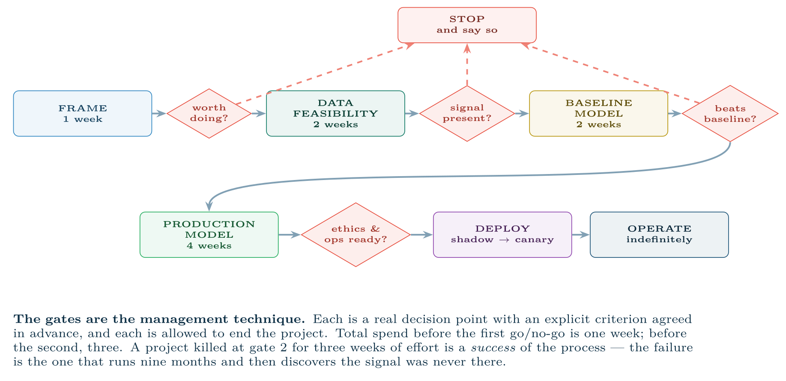
A data science project as a sequence of decision gates
FIGURE 30.1
Because feasibility is unknown at the start, the plan must be structured to discover it cheaply and to permit an honourable stop.
Data Science · Chapter 30 · Managing Data Science Projects
§30.2 · Handout p. 197 10
Notes:
Figure 30.1 (handout p. 197): A data science project as a sequence of decision gates. Because feasibility is unknown at the start, the plan must be structured to discover it cheaply and to permit an honourable stop.

Slide 11

Make Stopping Respectable
CONCEPT
Teams continue doomed projects because stopping looks like failure. Fix this with process: name the gates and their criteria in the project charter, so that stopping at a gate is the plan working rather than the team losing. A group that has killed projects at gate 2 is more trustworthy than one that has never killed anything.
Data Science · Chapter 30 · Managing Data Science Projects
§30.2 · Handout p. 197 11
Notes:
Read the box aloud, then ask for an example from the room before moving on.

Slide 12
Estimation Under Genuine Uncertainty
SECTION 3 OF 5
30.3
30.1 Why Data Science Projects Are Different
30.2 Gates, Not a Plan
30.3 Estimation Under Genuine Uncertainty
30.4 Metrics and Dashboards
30.5 Risk
Data Science · Chapter 30
Handout §30.3 12
Notes:
Pause. Name the question this section answers.

Slide 13

Estimating a Task Nobody Can Estimate
WORKED EXAMPLE
“How long to build the dropout model?”
The wrong answer: “six weeks” — a single number, which will be treated as a commitment and will be wrong.
Better — decompose by uncertainty type.
Data Science · Chapter 30 · Managing Data Science Projects
§30.3 · Handout p. 197 13
Notes:
Each click adds one step of the working. Ask for the next number before you reveal it.

Slide 14
Estimating a Task Nobody Can Estimate (continued)
WORKED EXAMPLE
Activity | Estimate | Why this confidence
Data access and permissions | 1–4 weeks | Depends on other people; historically the longest pole
Data audit and cleaning | 2 weeks ±1 | Similar to three past projects
Feature engineering | 1–3 weeks | Depends on what the audit reveals
Baseline model | 3 days | Genuinely routine
Reaching the target metric | unbounded | May be impossible
Deployment and monitoring | 2 weeks | Reference class exists
What to actually commit to. Not the outcome, but the gate: “In three weeks we will report whether the data contains enough signal to reach 70% recall at 20% flag rate. If it does, delivery is a further 6–8 weeks. If it does not, we will recommend stopping and explain why.”
Data Science · Chapter 30 · Managing Data Science Projects
§30.3 · Handout p. 197 14
Notes:
Each click adds one step of the working. Ask for the next number before you reveal it.

Slide 15
Estimating a Task Nobody Can Estimate (continued)
WORKED EXAMPLE
Why this is better management, not evasion. It commits to a date, a deliverable and a decision — all of which are within the team’s control — and declines to commit to a result that is not. A stakeholder given this can plan; a stakeholder given “six weeks” cannot, because the number is fiction.
Data Science · Chapter 30 · Managing Data Science Projects
§30.3 · Handout p. 197 15
Notes:
Each click adds one step of the working. Ask for the next number before you reveal it.

Slide 16

Spike
DEFINITION
A strictly time-boxed investigation whose deliverable is knowledge, not working software: “spend three days determining whether the clickstream contains week-4 signal.” The time box is the point — it converts open-ended research into a bounded commitment.
Data Science · Chapter 30 · Managing Data Science Projects
§30.3 · Handout p. 197 16
Notes:
Read the box aloud, then ask for an example from the room before moving on.

Slide 17
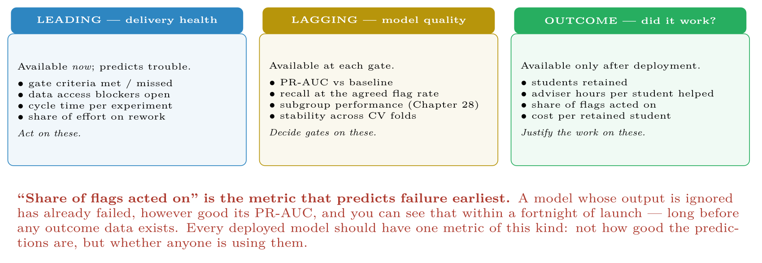
Three kinds of project metric, ordered by when each becomes available
FIGURE 30.2
Leading indicators are for acting on, lagging for deciding gates, outcome measures for justifying the work.
Data Science · Chapter 30 · Managing Data Science Projects
§30.4 · Handout p. 198 17
Notes:
Figure 30.2 (handout p. 198): Three kinds of project metric, ordered by when each becomes available. Leading indicators are for acting on, lagging for deciding gates, outcome measures for justifying the work.

Slide 18
Risk
SECTION 5 OF 5
30.5
30.1 Why Data Science Projects Are Different
30.2 Gates, Not a Plan
30.3 Estimation Under Genuine Uncertainty
30.4 Metrics and Dashboards
30.5 Risk
Data Science · Chapter 30
Handout §30.5 18
Notes:
Pause. Name the question this section answers.

Slide 19
Risk
AT A GLANCE
Risk | Likelihood | Mitigation
The data lacks the signal | High | Gate 2 at three weeks; agree in advance that this ends the project
Data access takes months | High | Start the request on day one, in parallel with everything else
Leakage inflates results | High | Independent review of the split and features (Chapter 7)
Stakeholder expects certainty | High | Communicate in ranges and probabilities from the first meeting (Chapter 31)
The model is unfair to a subgroup | Moderate | Subgroup metrics in the gate criteria, not after deployment
Nobody uses the output | Moderate | Frame around the decision (Chapter 2); involve the user from gate 1
Model decays after launch | Certain | Budget ongoing MLOps effort from the start (Chapter 27)
Key person leaves | Moderate | Reproducible pipelines, not notebooks (Chapter 29)
Data Science · Chapter 30 · Managing Data Science Projects
§30.5 · Handout p. 198 19
Notes:
Do not read the table row by row: pick the row the room is most likely to get wrong and ask why.

Slide 20
Budget for After Launch
WATCH OUT
The commonest structural error in data science project planning is treating deployment as the end. A deployed model needs monitoring, periodic retraining, incident response and eventual retirement. Plan roughly 20–30% of the build effort per year, indefinitely. A project plan that ends at deployment is planning a system that will silently decay (Figure 19.4).
Data Science · Chapter 30 · Managing Data Science Projects
§30.5 · Handout p. 198 20
Notes:
Read the box aloud, then ask for an example from the room before moving on.

Slide 21





Four lenses: Managing the Work
FOUR LENSES
LEARNING ANALYTICS
PROJECT MANAGEMENT
Education projects have an immovable constraint the others do not: the academic calendar.
This chapter is the project-management lens in full.
INTERNET OF THINGS
CYBERSECURITY
The critical path runs through hardware procurement, not software.
Success is invisible — the business case rests on incidents that did not occur — so agree the metrics before starting: mean time to detect, mean time to respond, coverage of monitored assets, alerts per analyst.
Data Science · Chapter 30 · Managing Data Science Projects
Handout p. 201 21
Notes:
The same method, four domains. Each of the next four slides opens one lens in full.

Slide 22

Learning Analytics: Managing the Work
FOUR LENSES
LEARNING ANALYTICS
Project Management
Education projects have an immovable constraint the others do not: the academic calendar. A model that misses the start of semester is useless for a year, and you cannot compress a cohort. Plan backwards from week 1 of the semester, and note that gate criteria involving student outcomes take a full term to evaluate — so the first genuine outcome evidence arrives after the second deployment.
Internet of Things
Cybersecurity
Data Science · Chapter 30 · Managing Data Science Projects
Handout p. 201 22
Notes:
Learning Analytics. Education projects have an immovable constraint the others do not: the academic calendar. A model that misses the start of semester is useless for a year, and you cannot compress a cohort. Plan backwards from week 1 of the semester, and note that gate criteria involving student outcomes take a full term to evaluate — so the first genuine outcome evidence arrives after the second deployment.

Slide 23

Project Management: Managing the Work
FOUR LENSES
PROJECT MANAGEMENT
Learning Analytics
This chapter is the project-management lens in full. The distilled version: gate the project so infeasibility is discovered in weeks rather than months, commit to decisions rather than to outcomes, and budget for the operating phase from the beginning.
Internet of Things
Cybersecurity
Data Science · Chapter 30 · Managing Data Science Projects
Handout p. 201 23
Notes:
Project Management. This chapter is the project-management lens in full. The distilled version: gate the project so infeasibility is discovered in weeks rather than months, commit to decisions rather than to outcomes, and budget for the operating phase from the beginning.

Slide 24

Internet of Things: Managing the Work
FOUR LENSES
INTERNET OF THINGS
Learning Analytics
The critical path runs through hardware procurement, not software. Sensors have lead times, sites need physical access, and connectivity contracts take weeks. Pilot on 20 devices before committing to 4,000: fleet failure modes are invisible at bench scale, and the cost of discovering them post-deployment is measured in site visits. Budget for the fact that firmware updates across a fleet are themselves a project.
Project Management
Cybersecurity
Data Science · Chapter 30 · Managing Data Science Projects
Handout p. 201 24
Notes:
Internet of Things. The critical path runs through hardware procurement, not software. Sensors have lead times, sites need physical access, and connectivity contracts take weeks. Pilot on 20 devices before committing to 4,000: fleet failure modes are invisible at bench scale, and the cost of discovering them post-deployment is measured in site visits. Budget for the fact that firmware updates across a fleet are themselves a project.

Slide 25

Cybersecurity: Managing the Work
FOUR LENSES
CYBERSECURITY
Learning Analytics
Success is invisible — the business case rests on incidents that did not occur — so agree the metrics before starting: mean time to detect, mean time to respond, coverage of monitored assets, alerts per analyst. Detection engineering is continuous maintenance rather than a delivery, so the operating budget is not optional. And note the tension with Chapter 29: publishing your method helps attackers, which constrains how openly the project can be documented.
Project Management
Internet of Things
Data Science · Chapter 30 · Managing Data Science Projects
Handout p. 201 25
Notes:
Cybersecurity. Success is invisible — the business case rests on incidents that did not occur — so agree the metrics before starting: mean time to detect, mean time to respond, coverage of monitored assets, alerts per analyst. Detection engineering is continuous maintenance rather than a delivery, so the operating budget is not optional. And note the tension with Chapter 29: publishing your method helps attackers, which constrains how openly the project can be documented.

Slide 26

Try it yourself: A Project Charter That Fits on One Page
TRY IT YOURSELF
THIS WEEK'S LAB
WHAT YOU WILL RUN
Week 16: Monitored service; fairness measurement
1 listing, 28 lines of Text
Data Science · Chapter 30 · Managing Data Science Projects
§30.5 · Handout p. 198 26
Notes:
Say what the room will have at the end of the lab, then let them start. Circulate rather than lecture.

Slide 27
A Project Charter That Fits on One Page
LAB · STEP 1 OF 2
Set-up
Text
1
2
3
4
5
6
7
8
9
10
11
12
13
14
15
16
17
PROJECT Early identification of at-risk first-year students
SPONSOR Head of Department DATE 2026-09-01
DECISION Which students receive an outreach call in week 5.
(If no decision changes, there is no project.)
USERS Three academic advisers. Involved from gate 1, not shown a demo at the end.
SUCCESS >= 70% of eventual failures identified, flagging <= 20% of the cohort.
BASELINE Current rule ("missed two labs") achieves ~45% recall at 15% flag rate.
The model must beat THIS, not chance.
GATES
G1 wk 1 Framing agreed, data access requested, decision confirmed -> go/no-go
G2 wk 3 Signal check: can ANY model reach 60% recall at 20% flags? -> go/no-go
G3 wk 5 Baseline beaten on walk-forward validation -> go/no-go
G4 wk 9 Subgroup fairness within 5pp; monitoring plan signed off -> go/no-go
Stopping at any gate is a valid, expected outcome.
Data Science · Chapter 30 · Managing Data Science Projects
§30.5 · Handout p. 198 27
Notes:
Step 1: Set-up. Read the code aloud; ask what each line would print before running it.

Slide 28
A Project Charter That Fits on One Page
LAB · STEP 2 OF 2
Text
18
19
20
21
22
23
24
25
26
27
OUT OF SCOPE Grading, disciplinary use, any automated action without a human.
ETHICS Equal opportunity as the fairness criterion (approved by X, 2026-09-01).
Counterfactual explanation shown to the adviser. Student may contest.
TOP RISKS 1. Signal absent -> G2 kills the project at 3 weeks
2. Data access slow -> requested day 1; escalation path named
3. Leakage -> split and features reviewed by Y at G3
AFTER LAUNCH 0.5 day/week monitoring; annual retrain per cohort; owner named: Z.
Review for retirement after 3 years.
Data Science · Chapter 30 · Managing Data Science Projects
§30.5 · Handout p. 198 28
Notes:
Read the code aloud; ask what each line would print before running it.

Slide 29
What the lab shows
TRY IT YOURSELF
Everything on this page is a commitment the team can keep. Note what is absent: a promised accuracy figure, and a delivery date for a result nobody can yet know is achievable.
Data Science · Chapter 30 · Managing Data Science Projects
§30.5 · Handout p. 198 29
Notes:
Read the box aloud, then ask for an example from the room before moving on.

Slide 30

Why can a data science project not be planned the way a software feature can? Name the specific property.
CHECKPOINT 1 OF 3
Discuss with the person next to you, then advance.
Data Science · Chapter 30 · Managing Data Science Projects
Handout p. 201 · answers in Appendix D 30
Notes:
Ask the room. Do not advance until someone commits to an answer.

Slide 31

Why can a data science project not be planned the way a software feature can? Name the specific property.
CHECKPOINT 1 OF 3 · ANSWER
Feasibility is unknown at the start. In software you know the feature can be built and estimate how long; here the signal may simply not be in the data, and no planning discipline can determine that in advance.
Data Science · Chapter 30 · Managing Data Science Projects
Handout p. 201 · answers in Appendix D 31
Notes:
Answer (Appendix D): Feasibility is unknown at the start. In software you know the feature can be built and estimate how long; here the signal may simply not be in the data, and no planning discipline can determine that in advance.

Slide 32
A sponsor asks for a delivery date and an accuracy figure. What do you commit to instead, and how do you explain the difference?
CHECKPOINT 2 OF 3
Discuss with the person next to you, then advance.
Data Science · Chapter 30 · Managing Data Science Projects
Handout p. 201 · answers in Appendix D 32
Notes:
Ask the room. Do not advance until someone commits to an answer.

Slide 33
A sponsor asks for a delivery date and an accuracy figure. What do you commit to instead, and how do you explain the difference?
CHECKPOINT 2 OF 3 · ANSWER
Commit to a gate: a date, a deliverable and a decision — “in three weeks we will report whether the data supports 70% recall at a 20% flag rate.” Explain that a date is within your control and a result is not, and that a fabricated accuracy figure would be worse than useless for planning.
Data Science · Chapter 30 · Managing Data Science Projects
Handout p. 201 · answers in Appendix D 33
Notes:
Answer (Appendix D): Commit to a gate: a date, a deliverable and a decision — “in three weeks we will report whether the data supports 70% recall at a 20% flag rate.” Explain that a date is within your control and a result is not, and that a fabricated accuracy figure would be worse than useless for planning.

Slide 34
Your project is killed at gate 2 after three weeks. Was this a failure?
CHECKPOINT 3 OF 3
Discuss with the person next to you, then advance.
Data Science · Chapter 30 · Managing Data Science Projects
Handout p. 201 · answers in Appendix D 34
Notes:
Ask the room. Do not advance until someone commits to an answer.

Slide 35
Your project is killed at gate 2 after three weeks. Was this a failure?
CHECKPOINT 3 OF 3 · ANSWER
No — it is the process working. Three weeks of effort established that the project was not viable, instead of nine months. Naming the gates in advance is what makes this an outcome rather than a defeat.
Data Science · Chapter 30 · Managing Data Science Projects
Handout p. 201 · answers in Appendix D 35
Notes:
Answer (Appendix D): No — it is the process working. Three weeks of effort established that the project was not viable, instead of nine months. Naming the gates in advance is what makes this an outcome rather than a defeat.

Slide 36

What to take away
CHAPTER SUMMARY
1
Data science projects differ because feasibility is unknown until you try; planning must be built around discovering that cheaply.
2
Structure the work as decision gates with criteria agreed in advance, each able to end the project honourably.
3
Estimate by decomposing into activities of different uncertainty, and commit to gates and deliverables rather than to results.
4
Use time-boxed spikes for open-ended investigation.
5
Track leading indicators to act, lagging indicators to decide gates, and outcome measures to justify the work.
6
The largest planning error is treating deployment as the end. Budget 20–30% of build effort per year for operations, indefinitely.
Data Science · Chapter 30 · Managing Data Science Projects
Handout p. 201 36
Notes:
Ask the room to say each takeaway before you reveal it.

Slide 37

Quick check 1 of 2
REVIEW · MULTIPLE CHOICE
The distinctive risk of a data science project is:
the data may not support the question
A
scope creep
B
C
poor UI
D
server capacity
Data Science · Chapter 30 · Managing Data Science Projects
Handout p. 201 37
Notes:
Take a show of hands for each option before discussing. (The handout does not print MCQ answers.)

Slide 38
Quick check 2 of 2
REVIEW · MULTIPLE CHOICE
A time-boxed investigation whose output is knowledge is a:
A
sprint
B
spike
C
gate
D
epic
Data Science · Chapter 30 · Managing Data Science Projects
Handout p. 201 38
Notes:
Take a show of hands for each option before discussing. (The handout does not print MCQ answers.)

Slide 39
For your notebook
REVIEW QUESTIONS
SHORT
Explain why a project killed at an early gate can be a success of the process.
SHORT
Give two leading and two lagging indicators for a data science project, and say how each is used differently.
SHORT
Why must the operating phase be budgeted at the start rather than requested later?
APPLIED
Write a one-page charter for a predictive maintenance project on 150 HVAC units, including four gates with explicit criteria, three risks with mitigations, and what you commit to versus what you decline to commit to.
APPLIED
A sponsor says “the model must be 95% accurate”. Explain, in terms they would accept, why that specification is both unhelpful and possibly meaningless, and propose a replacement.
Data Science · Chapter 30 · Managing Data Science Projects
Handout p. 201 39
Notes:
Set these for independent study. Model answers are not printed in the handout.

Slide 40
End of Chapter 30
30
NEXT
READ
Chapter 31 — Communicating Data Science
Handout Chapter 30, pages 196–201
THIS WEEK'S LAB
ASSESSMENT
Monitored service; fairness measurement
Capstone due
Data Science · Chapter 30 · Managing Data Science Projects
40
Notes:
Close. NEXT: Chapter 31 — Communicating Data Science. READ: Handout Chapter 30, pages 196–201. THIS WEEK'S LAB: Monitored service; fairness measurement. ASSESSMENT: Capstone due.

